Slide 1
Circle Generating Algorithm

Slide 2
Bresenham’s Circle Generating Algorithm

Slide 3
Scan Converting a Circle
A circle is a symmetric figure. Any circle generating algorithm can take advantage of the circle’s symmetry to plot eight points for each value that the algorithm calculates. Eight way symmetry is used by reflecting each calculated point around each 45 º axis.

Slide 4
y
-y,x
y,x
-x,y
x,y
x
-x,-y
x,-y
y,-x
-y,-x

Slide 5
Scan Converting a Circle using Polynomial method:-
This method defines a circle with second order polynomial equation
y² = r² – x²
where x, y = x & y coordinates, r = radius
With this method, each x coordinate in the sector, from 90º to 45º, is found by stepping x from 0 to r / 2 , and each y coordinate is found by evaluating r² – x² for each step of x.

Slide 6
This is a very inefficient method, however, because for each point both x & r must be squared and subtracted from each other; then the square root of the result must be found.
y
P(x, r² – x² )
y
r
x
0
x

Slide 7
However, unsurprisingly this is not a brilliant solution!
Firstly, the resulting circle has large gaps where the slope approaches the vertical
Secondly, the calculations are not very efficient
The square (multiply) operations
The square root operation – try really hard to avoid these!
We need a more efficient, more accurate solution

Slide 8
Scan Convert a Circle using trigonometric
method:-
This second method of defining a circle uses functions : x = r cos θ, y = r sin θ
y
P(r cos θ,r sin θ)
r sin θ
θ
x
r cos θ

Slide 9
θ = current angle, r = circle radius
By this method θ is stepped from θ to π /4
& each value of x & y is calculated.
Computation of values of sin θ & cos θ are
very time consuming

Slide 10
Bresenham’s Circle Algorithm
Working: If the eight-way symmetry of a circle is used to generate a circle, points will have to be generated through 45º angle. And, if points are generated from 90º to 45º, moves will be made only in the +x and –y directions.
If points are generated from 90º to 45º each new point closest to the true circle can be found by taking either of two actions:
Move in the x direction one unit or
Move in the x direction 1 unit & -ve y direction 1 unit.

Slide 11
y
T
(xi+1,yi)
yi
(xi+1,yi-1)
yi -1
S
r
xi
xi + 1
x

Slide 12
Assume that (xi, yi) are the coordinates of the last scan-converted pixel upon entering step i.
Coordinates of
T are (xi +1, yi)
S are (xi +1, yi – 1)
Following expressions can be developed:
D(T) = (xi + 1)² + yi² – r²
D(S) = (xi + 1)² + (yi – 1)² – r²
This function D provides a relative measurement of the distance from the center of a pixel to the true circle. Since D(T) is always +ve (T is outside the circle) & D(S) will always be –ve (S is inside the true circle), a decision variable di can be defined as:

Slide 13
di = D(T) – (-D(S)) = D(T) + D(S)
Therefore,
di = 2(xi + 1)² + yi² + (yi – 1)² – 2r²
When di<0, we have |D(T)|<|D(S)| and pixel T
is chosen.
When di≥0, we have |D(T)|≥|D(S)| and pixel S
is selected.
Decision variable for next step:
d_{i+1} = 2(x_{i+1} + 1)² + y_{i+1}² + (y _{i+1} – 1)² – 2r²

Slide 14
Hence,
d_{i+1} – di = 2(x_{i+1} + 1)² + y_{i+1}² + (y_{i+1} – 1)² -
2(xi + 1)² - yi² - (yi – 1)²
Since x_{i+1} = xi + 1, we have
d_{i+1} = di + 4xi + 2(y_{i+1}² - yi²) – 2(y_{i+1} – yi) + 6
➔If T is chosen pixel (meaning that di < 0) then y_{i+1} = yi and so d_{i+1} = di + 4xi + 6
➔If S is chosen (meaning that di > 0) then y_{i+1} = yi –1 and so d_{i+1} = di + 4(xi-yi) + 10

Slide 15
Hence we have
d_{i+1} = di + 4xi + 6 if di < 0
di + 4(xi-yi) + 10 if di > 0
Finally, we set(0,r) to the starting pixel coordinates and compute d1 from the original definition of di:
x = 0, y = r
d1= 2(0 + 1)² + r² + (r-1)² – 2r²
d1= 3 – 2r

Slide 16
Algorithm:
For generating all the pixel coordinates in the
90º to 45º octant that are needed when scan-
converting a circle of radius r.
int x = 0, y = r, d = 3-2r
while (x<= y)
{
setpixel(x,y)
if (d < 0)
d = d + 4x + 6
else
{
d = d + 4(x - y) + 10
y--
}
x++
}

Slide 17
circlePlotPoints(xCenter, yCenter, x, y);
void circlePlotPoints (int xCenter, int yCenter, int x, int y)
{
setPixel (xCenter + x, yCenter + y);
setPixel (xCenter – x, yCenter + y);
setPixel (xCenter + x, yCenter – y);
setPixel (xCenter – x, yCenter – y);
setPixel (xCenter + y, yCenter + x);
setPixel (xCenter – y, yCenter + x);
setPixel (xCenter + y, yCenter – x);
setPixel (xCenter – y, yCenter – x);
}

Slide 18
Eight-Way Symmetry
The first thing we can notice to make our circle drawing algorithm more efficient is that circles centred at (0, 0) have eight-way symmetry.
(-x, y)
(x, y)
(-y, x)
(y, x)
(-y, -x)
(y, -x)
(-x, -y)
(x, -y)

Slide 19
Mid Point Circle Drawing Algorithm

Slide 20
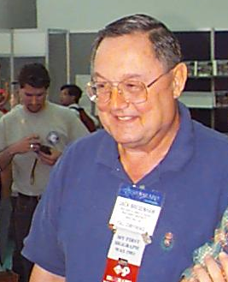
Mid-Point Circle Algorithm
Similarly to the case with lines, there is an incremental algorithm for drawing circles – the mid-point circle algorithm
In the mid-point circle algorithm we use eight-way symmetry so only ever calculate the points for the top right eighth of a circle, and then use symmetry to get the rest of the points
The mid-point circle algorithm was developed by Jack Bresenham

Slide 21
Midpoint Circle Algorithm
Mid point algorithm is very similar to Bresenham’s approach. It is based on the following function for testing the spatial relationship between an arbitrary point(x,y) and a circle of radius centered at the origin:
< 0 (x,y) inside circle
f(x,y) = x² + y² – r² = 0 (x,y) on the circle
> 0 (x,y) outside circle

Slide 22
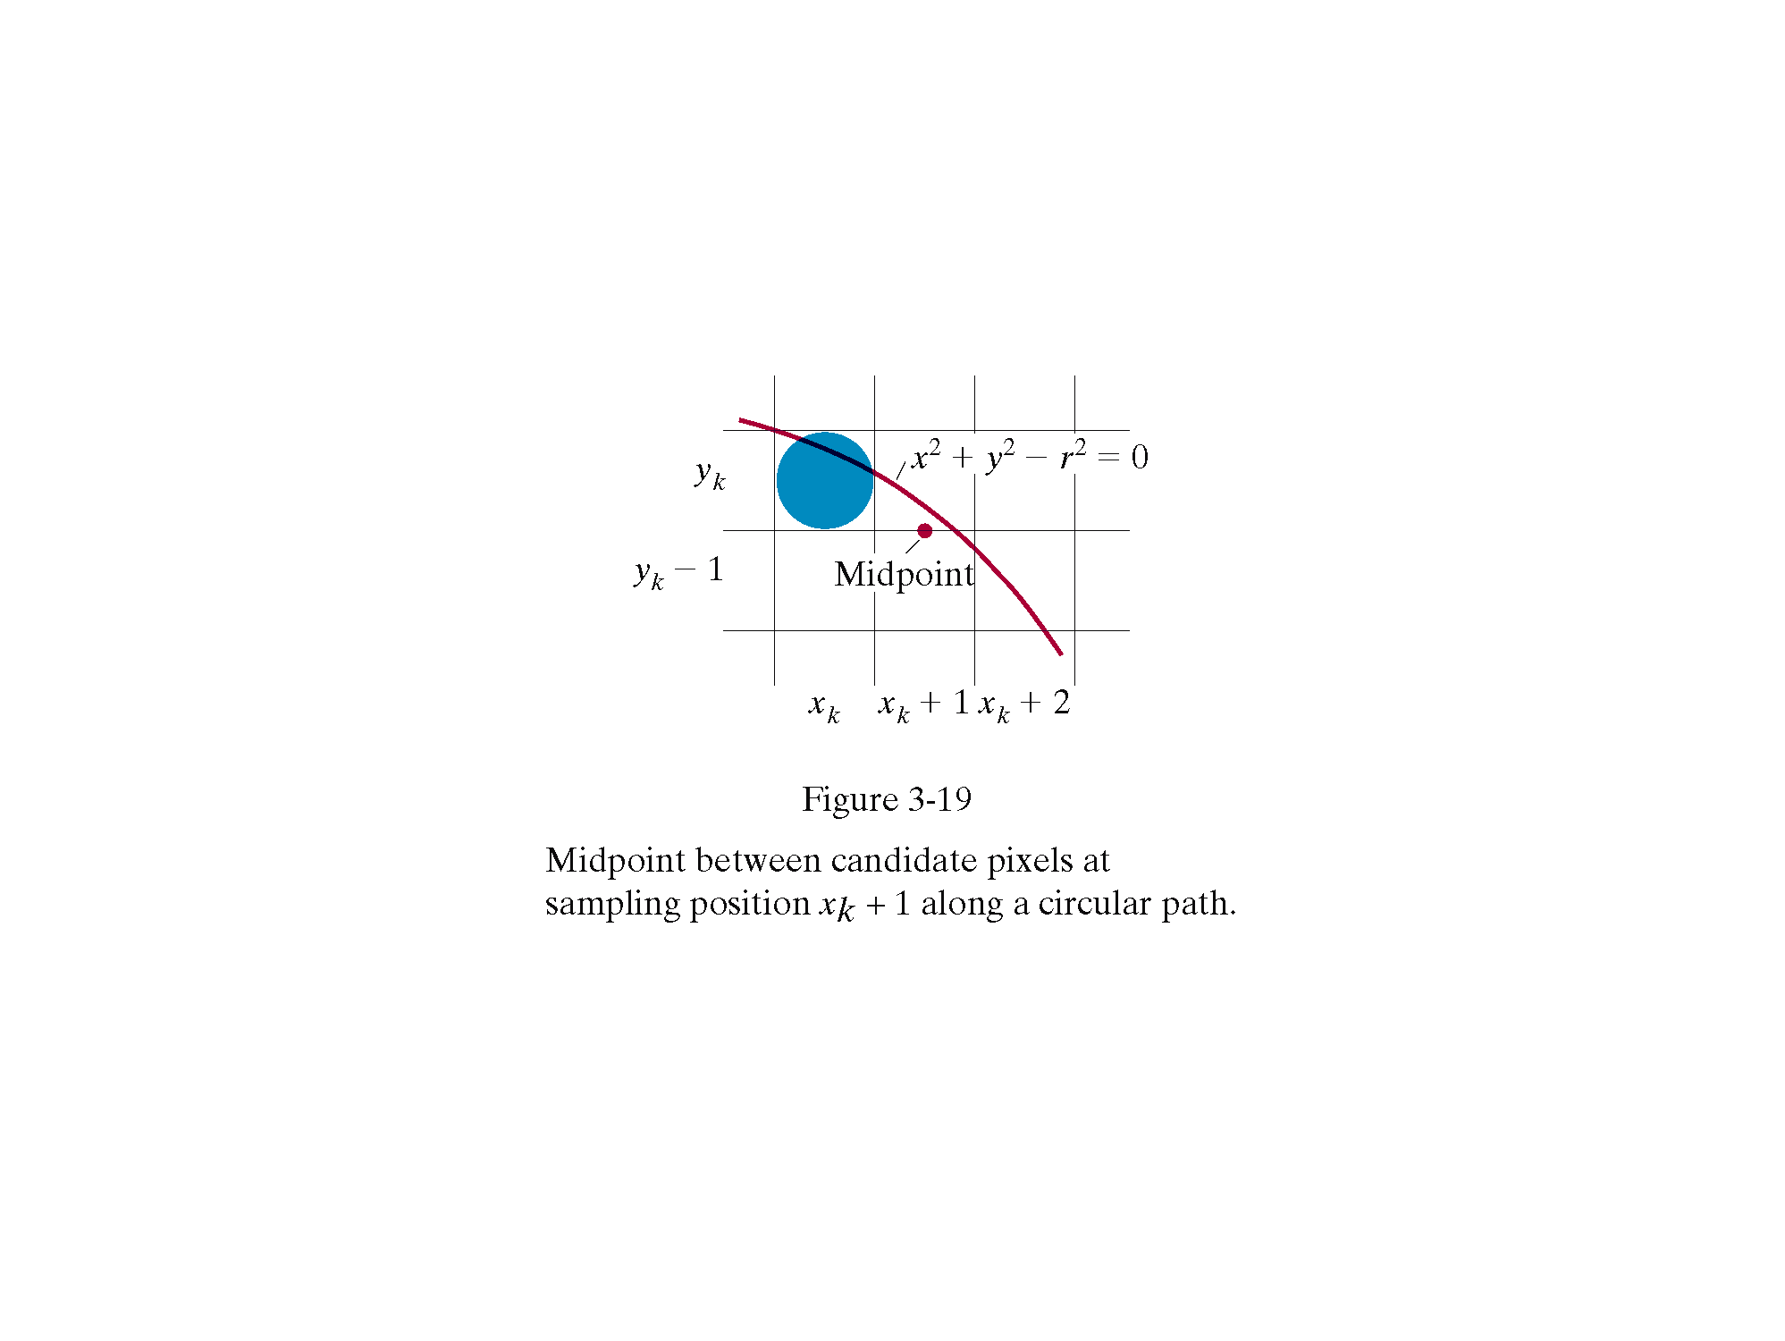

Slide 23
Now consider the coordinates of the point halfway between pixel T & S (xi + 1, yi – ½) This is called the midpoint and we use it to define a decision parameter:
pi = f( xi +1, yi – ½)
= (xi + 1)² + (yi – ½)² – r²
If pi is –ve , the midpoint is inside the circle, then we choose pixel T.
If pi is +ve, the midpoint is outside the circle, & we choose S.

Slide 24
Similarly, the decision parameter for the next
step is:
p_{i+1} = (x_{i+1} + 1)² + (y_{i+1} – ½)² – r²
Since x _{i+1} = xi + 1
p_{i+1} - pi = [(xi + 1)+ 1]² – (xi + 1)²
+ (y _{i+1} – ½)² – (yi – ½)²
Hence
p_{i+1} = pi + 2(xi + 1) + 1 + (y _{i+1}² – yi²)
– (y _{i+1} – yi)

Slide 25
➔If pixel T is chosen (meaning pi < 0), we have y_{i+1} = yi.
➔If pixel S is chosen (meaning pi > 0), we have y_{i+1} = yi – 1. Thus,
p_{i+1}= pi + 2(xi + 1) +1 if pi<0
pi + 2(xi + 1) +1 – 2(yi – 1) if pi>0
In terms of (xi, yi), we have
p_{i+1}= pi + 2xi + 3 if pi<0
pi + 2(xi - yi ) + 5 if pi>0

Slide 26
Finally, we compute the initial value for the decision parameter using the original definition of pi and (0,r):
pi = (0 + 1)² + (r – ½)² – r² = 5/4 – r
One can see that this is not really integer computation. However, when r is an integer we can simply set p1= 1 – r.
The error of being ¼ less than the precise value does not prevent p1 from getting the appropriate sign.

Slide 27
It does not affect the rest of the scan conversion process, because the decision variable is only updated with integer increment in subsequent steps.

Slide 28
Mid Point Circle Algorithm:
The following is a description of this midpoint circle algorithm that generates the pixel coordinates in the 90˚ to 45 ˚ octant:
int x = 0, y = r, p = 1-r
while (x <=y)
{ setpixel(x,y);
if (p < 0)
p = p + 2x + 3
else {
p = p + 2(x – y) + 5
y- -
}
x++
}

Slide 29
circlePlotPoints(xCenter, yCenter, x, y);
void circlePlotPoints (int xCenter, int yCenter, int x, int y)
{
setPixel (xCenter + x, yCenter + y);
setPixel (xCenter – x, yCenter + y);
setPixel (xCenter + x, yCenter – y);
setPixel (xCenter – x, yCenter – y);
setPixel (xCenter + y, yCenter + x);
setPixel (xCenter – y, yCenter + x);
setPixel (xCenter + y, yCenter – x);
setPixel (xCenter – y, yCenter – x);
}

